Slide 1
Land Based Investment Strategy
Fish Passage
BCTS – Kootenay Business Area
Phil MacDonald, Engineering Specialist
250-825-1138
October 29th, 2013

Slide 2
Federal Fisheries Act, Sec. 66
“every owner or occupier of an obstruction across or in any stream who refuses or neglects to provide and maintain a fish-way...and free fish passage...is guilty of an offence...”

Slide 3
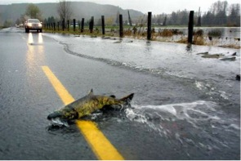

Slide 4
Why Should We Care?
320,000 fish stream crossings in BC (approx)
About 225,000 are closed-bottom culverts
135,000-200,000 likely impede fish passage
Only about 22,400 culvert assessment done
Thousands of culverts to fix; thousands of kilometres of habitat to re-connect
We’ve fixed 117 in the last 5 years...a long way to go!!

Slide 5
LBIS – Fish Passage Program Goal
Assess the highest priority watersheds for fish stream crossings that may present barriers to fish
Habitat Confirmations on highest priority crossings to determine habitat gain
Site plans and designs on highest priority crossings to determine most appropriate remediation
Remediate highest priority crossings
Monitor and report progress (PSCIS database)

Slide 6
BCTS Kootenay
2012/13 Accomplishments
  Fish Passage Assessments – Boundary (Granby, Kettle, & Boundary Ck Watersheds)
    411 Crossing Surveyed (29 High and 48 Moderate Priority for Remediation)
  Fish Passage Assessments – Arrow/Kootenay Lake (Slocan & Kootenay Watersheds)
    357 Crossings Surveyed (19 High and 15 Moderate Priority for Remediation)

Slide 7
BCTS Kootenay
2012/13 Accomplishments (continued)
  Fish Passage Assessments Rocky Mountain (White, Kootenay, Elk, Flathead Watersheds)
    926 Crossings Surveyed (71 High and 134 Moderate Priority for Remediation)
  Habitat Confirmation Assessments Completed
    Rocky Mountain – 6 High Priority Crossings identified
    Boundary – 3 High Priority Crossings identified
  Bridge Designs completed for 2 sites, 6m and 9m bridges fabricated.

Slide 8
BCTS Kootenay
2013/14 Accomplishments
  Crossing replacement on 2 sites on East White River postponed due to June 20th storm event.
  Fish Passage Assessments – NAKFOR Op Areas
    Results pending
  Habitat Confirmation Assessments
    Boundary – 32 Sites Assessed (results pending)
    Arrow/Kootenay – 34 Sites Assessed (results pending)

Slide 9
2014/15 Goals
Kootenay Business Area budget = $310,000
Install 2 crossings East White River
Complete Bridge Site Plans & Designs for 6 to 8 high priority crossings (Rocky Mountain, Boundary, Arrow/Kootenay)
Initiate remediation works
Continue Habitat Confirmation Checks
Solicit Licensees for Project Areas

Slide 10
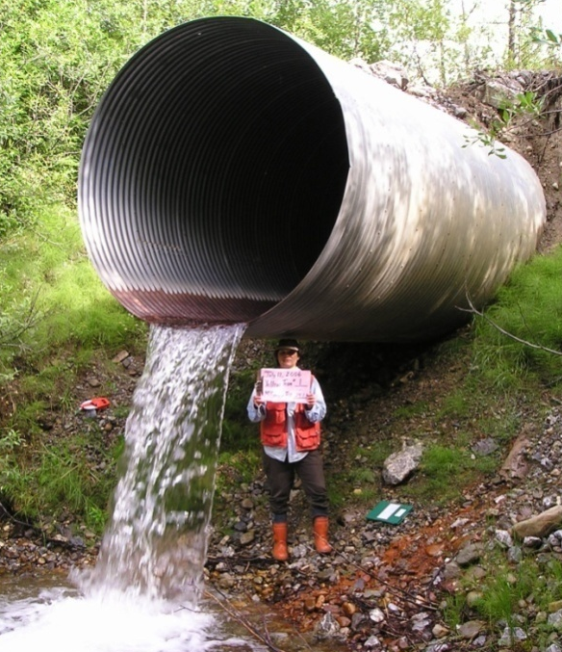
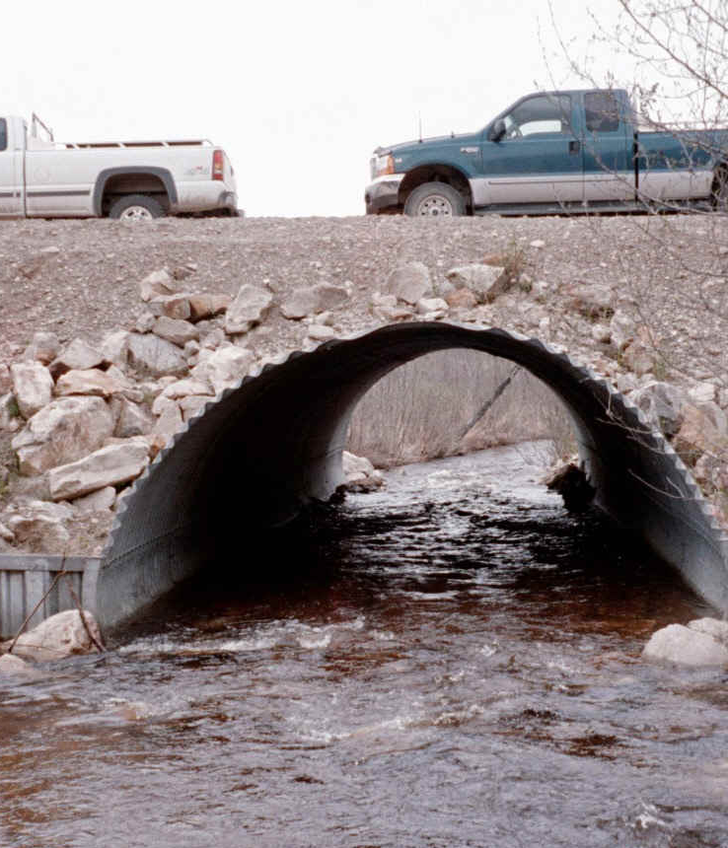
NOT THIS
THIS

